Slide 1
Thailand Biomass Case Study
Martin Krause
March 19, 2012

Slide 2

Biomass power generation and co-generation project
Capacity building, policy support, access to finance, pilots
Focus extended from biomass alone to a broader set of RE technologies
“Significant influence on growth of RE sector in Thailand”
Energy for Environment Foundation, Ministry of Energy
2001-2009

Slide 3
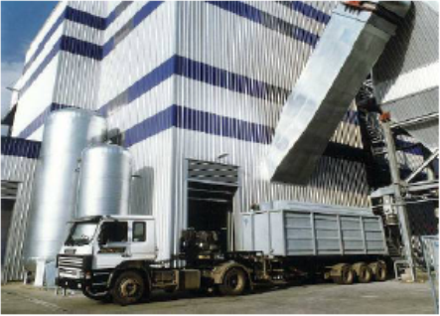
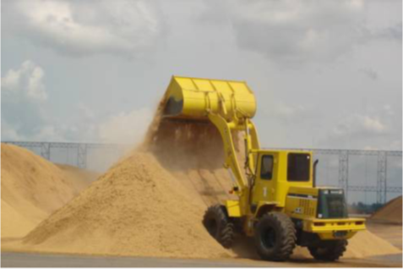

Slide 4
Main achievements
Contributed to adoption of adder tariffs
Information services
Reduction of grid-connection fee for small power producers from THB 2 million to THB 400,000
Raised capacity threshold for power sold to the grid from 1 MW to 10 MW
At least 10 local banks provide finance for RE projects

Slide 5
Effect of Adder Policy on Biomass Energy Investments in Thailand
Notes:
Newly installed capacity more than doubled in one year.
$1.2 billion in new investments channeled toward biomass power plants.

Slide 6
Registered CDM Biomass Energy Projects in Thailand
Title | MWel | Investment MUS$ | Investment US$/kW | IRR
A.T. Biopower Rice Husk Power Project in Pichit, Thailand | 20.0 | 32.0 | 1,600 | n/a
Dan Chang Bio-Energy Cogeneration project (DCBC) | 41.0 | 46.8 | 1,141 | 8.93%
Decha Bio Green Rice Husk Power Generation 7.5MW | 7.5 | n/a | n/a | n/a
Grid-connected Electricity Generation from Biomass at Advance Biopower | 9.5 | 14.6 | 1,540 | 12.80%
Khon Kaen Sugar Power Plant | 30.0 | 32.2 | 1,072 | 10.30%
Mungcharoen Green Power - 9.9 MW Rice Husk Fired Power Plant Project | 9.9 | 19.3 | 1,954 | 14.61% (Equity IRR)
Phu Khieo Bio-Energy Cogeneration project (PKBC) | 41.0 | 49.0 | 1,195 | 7.66%
Power Prospect 9.9MW Rice Husk Power Plant | 9.9 | 21.4 | 2,164 | 12.63%
Surat Thani Biomass Power Generation Project in Thailand | 8.9 | 25.7 | 2,891 | n/a

Slide 7
Fuel price risk

Slide 8
Fuel price risk (cont’d)
Effect of Bagasse Prices on Dan Chang Project IRR
 | Bagasse price (US$/tonne)
 | 10 | 15 | 20 | 25 | 30
Project IRR excluding CER revenue (%) | 12.6 | 9.2 | 5.6 | 1.6 | -2.9
Source: Sustainable Energy Technology at Work

Slide 9
The Business Case
Investing in biomass power projects makes business sense if:
there is a supportive policy environment
there is ready access to commercial finance at favorable terms
fuel price risk is effectively mitigated
there is biomass fuel security
support from the local community has been secured

Slide 10

Thank you!
Martin Krause
Team Leader
Environment and Energy
UNDP Asia-Pacific Regional Centre
Bangkok, Thailand
martin.krause@undp.org

