Slide 1
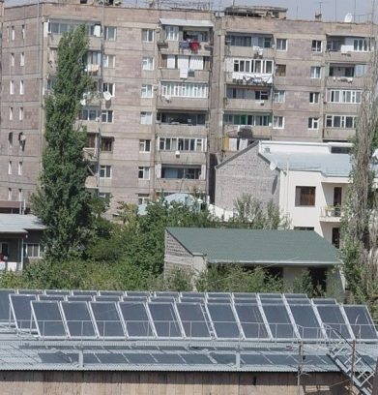
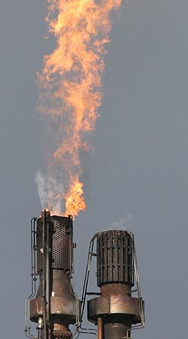
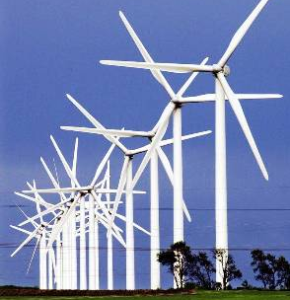

Energy efficiency in SME industries and manufacturing units through PECSME project
Business Opportunities in Viet Nam
Martin Krause
19 March 2012, New Delhi

Slide 2
PECSME project background
The project development goal is
to reduce the annual growth rate of GHG emissions through the removal of key barriers to the adoption of EE technologies and practices in the SME sector
To achieve this goal
Component 1: Policy and institutional support development program
Component 2: Communications and improving awareness on energy conservation
Component 3: Technical capacity development program
Component 4: Energy efficiency services provision support program
Component 5: Financing support program
Component 6: Demonstration program

Slide 3
Why PECSME is considered as a successful project
Sector | No. of DEMO | No. of DIRECT | No. of INDIRECT | Total | Energy Savings to 31 March 2011 (ktoe) | CO₂ Reductions to 31 March 2011 (kt) | Actual Invest-ment (USD million) ***
Brick | 3 | 150 | 57 | 210 | 149.6 | 579.4 | 23.61
Ceramics | 3 | 93 | 37 | 133 | 33.5 | 171.0 | 2.90
Food-processing | 2 | 95 | 10 | 107 | 10.4 | 40.0 | 1.60
Textile | 2 | 30 | 15 | 47 | 6.0 | 24.3 | 0.92
Paper | 2 | 42 | 2 | 46 | 6.3 | 25.2 | 0.95
Total | 12 | 410 | 121 | 543 | 205.8* | 839.9** | 29.98
* Equivalent to 151% of current approved target of 136.1 ktoe
** Equivalent to 156% of current approved target of 538.8 kt CO_{2eq}
*** Only investments of DEMO and IMPA projects included.

Slide 4
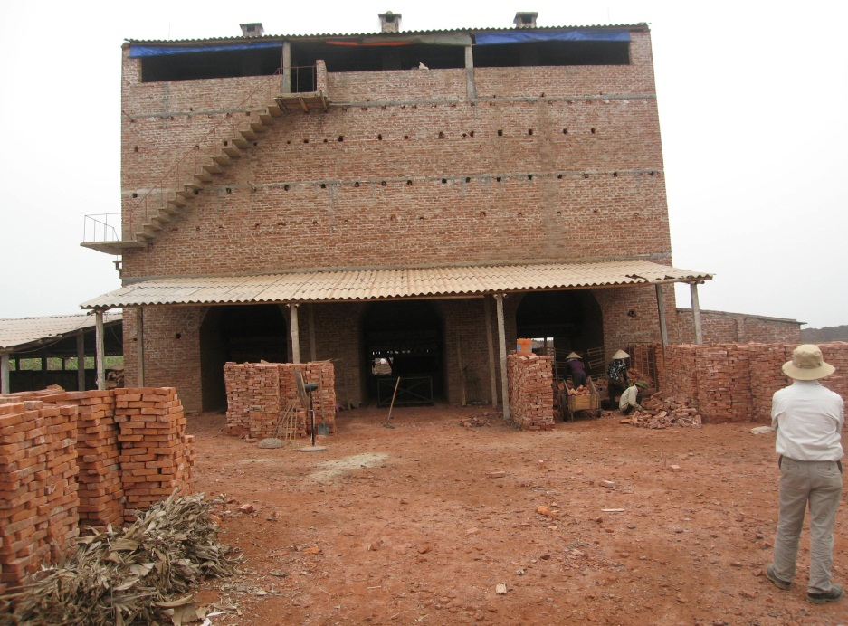
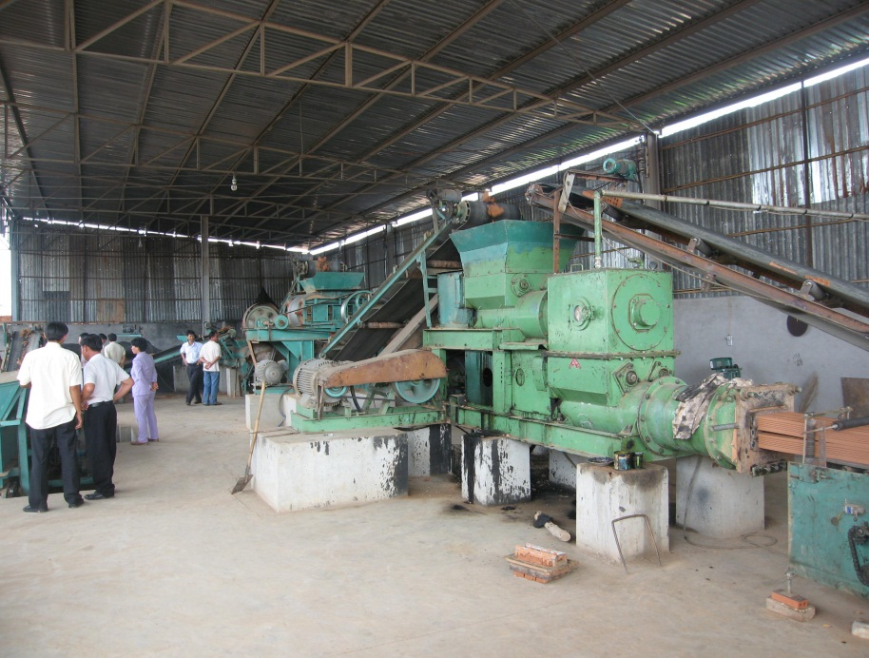
Technology intervention details - brick sectors
The average specific energy consumption - various technologies
traditional brick kilns is 1,507 kJ/kg of fired product
tunnel kilns 1,354 kJ/kg fired product
VSBK is 844 kJ/kg fired product
VSBK with 3 burning chambers at Hai Duong
Mechanization demonstration at Binh Duong province

Slide 5
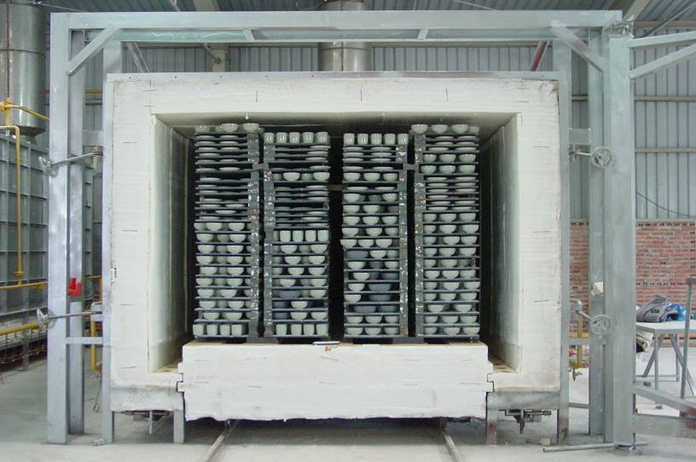
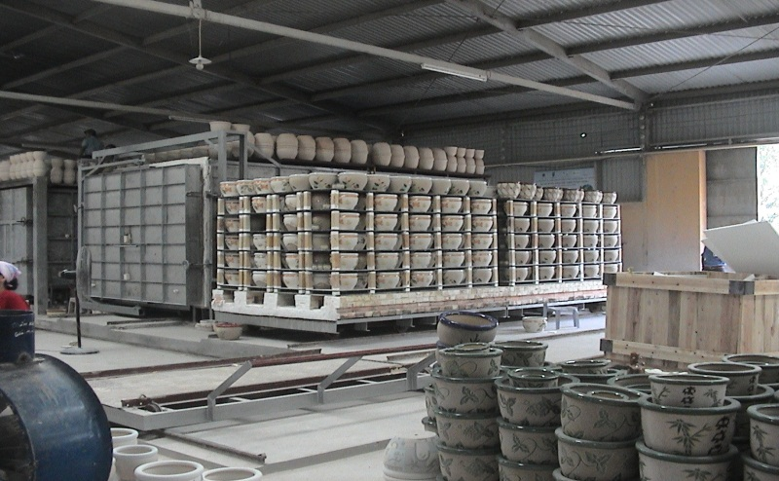


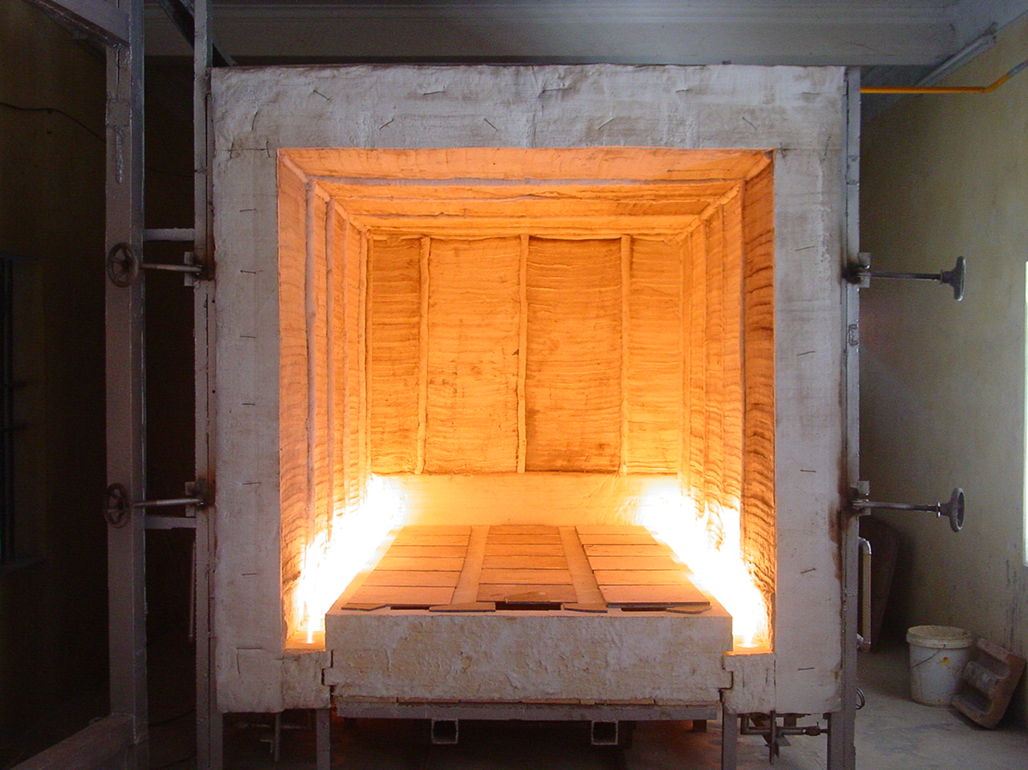
Technology intervention details - ceramic sectors
High temperature zone
Vïng nhiÖt cao
Ceramic kiln of 26 m³ at Chu Đậu
Vïng nhiÖt yÕu
Low temperature zone
The average specific energy consumption of
traditional kiln is 18,744 kJ/kg of product
LPG kiln is 10,858 kJ/kg of product
Anti-heat ceramic flake at the kiln’s walls

Slide 6
Cost of changes to product lines: cost-benefit analysis
Financial parameter | Duc Manh (in Binh Thuan) Brick enterprise | Tuan Anh Brick Manufacturing Private Enterprise | Nguyen Thi Thuy Ceramics | Huynh Huong Ceramic Production Enterprise
Total investment (US$) | 505,161 | 182,346 | 31,905 | 43,869
Interest rate | 18% | 13% | 6% | 13%
IRR | 32% | 18% | 52% | 29%
Payback period | 3 years 3 months | 3 years 11 months | 2 year 5 months | 2 year 4 months
the internal rate of return (IRR) is quite high when compared to the interest rate and investments made in these businesses will certainly lead to high profitable margins.
The average payback period for investments in brick industries is around 3 years and ceramic industries is around 2 years
Notes:
Conti…

Slide 7
How the project has been mobilizing investments even after its completion
Loan Guarantee Fund (LGF)
The project has established LGF with US$ 1.7 million financed by GEF
LGF management was transferred to the National Science and Technology Development Fund(NAFOSTED) by the end of June 2011
Vietinbank is a trust bank, which provide service in loan guarantee issuance and LGF capital management
As on June 2011,
total of 51 guaranteed projects (LG contracts) (of which: Brick: 17; Ceramic: 33; and Paper & Pulp: 1),
with a total investment of US$ 4.4 million, whereas total loan provided by Vietinbank and Vietnam Environmental Protection Fund (VEPF) is US$ 2.1 million
Notes:
Conti…

Slide 8
Possible Replication Aspects
Brick sector
The replications in brick sector has been very successful and mobilized investments over US$ 23.5 million across 210 (both demonstration and replication projects) energy efficient brick kilns, which are VSBKs
Additional funds are available to this sector as soft loan in the form of National Environmental Protection Fund and subsidies from local governments for VSBKs
Ceramic sector
Over a total number of 133 demonstration and replication LPG kilns, US$ 2.9 million of investments were mobilized
This was supported by availability of finance (either through various SME banking schemes or equity)
The successful demonstrations in Bat Trang have significantly motivated other units in Bat Trang ceramics community as well as other ceramic industry clusters around Vietnam
Notes:
Conti…

Slide 9
Conclusions
The PECSME project has been particularly successful in the bricks and ceramics sectors due to ease of energy efficiency interventions replication
Energy efficiency interventions have high monetary benefits through attractive rate of return on investments and quick payback periods
By adapting energy efficiency interventions, SMEs are now more competitive, lower operating costs, improved working environment, reduced carbon footprint and their impact on the local environment
The successfully managed financial mechanism, such as LGF, enabled the enterprises to implement energy efficient technologies
This is also partly due to enabling policy environment which has helped to transform five key energy-intensive industries in Viet Nam to low-carbon production path
Notes:
Conti…

Slide 10
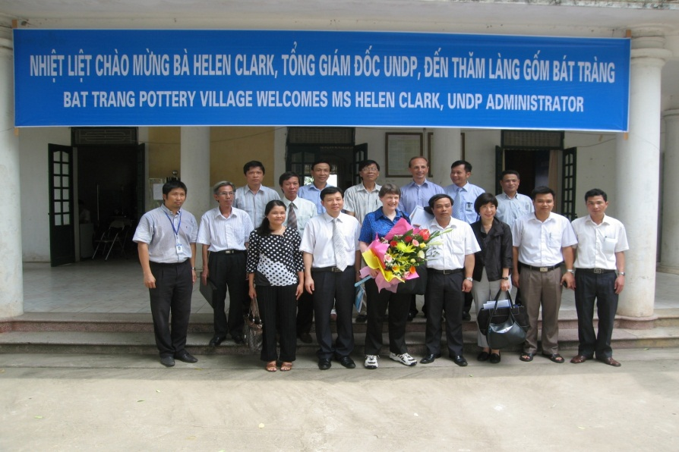
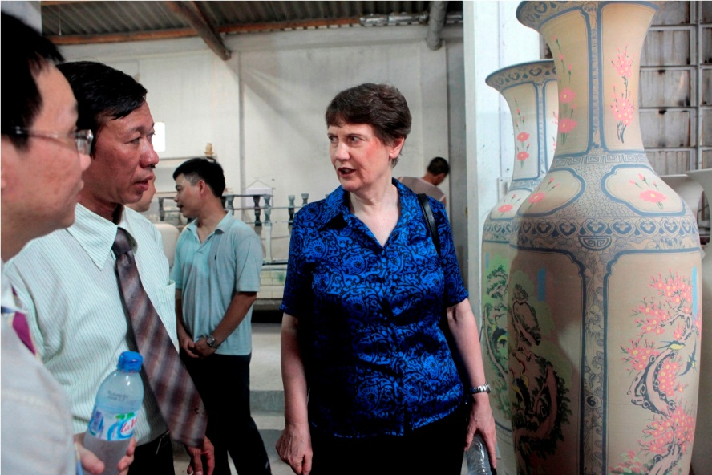
Thank you
For your kind attention
Notes:
Conti…

