Slide 1
MPK Steel-Energy Efficient
Manoj Upadhyay

Slide 2
Introduction
One of the largest manufacturer of structural steel in Rajasthan.
Unit commissioned in the year 2005 with 8-10 TPH capacity.
Consecutively won two ‘Energy Conservation Award’ from Rajasthan Government.
Only Unit in Rajasthan to use pulverized coal for re-heating billets from 100 mm to 250mm.

Slide 3
Challenges in Manufacturing Unit
How to increase output efficiency of the unit
High Energy Consumption
Keep up with new technology
Re-skill Employees

Slide 4
Cost of using Indigenous Technology
Low energy efficiency
Quality Parameters suffered
Lower than potential Mill Yield
High Crop Loss and Burning Loss
High Energy Cost increased pressure on profits

Slide 5
Joining Hands with UNDP/GEF Project (Steel)
Furnace Side
Use of high efficiency metallic recuperator
Adopting level-1 automation
Rolling Mill Side
Installation of drop tilters and tilting tables
Installation of energy efficient heavy duty motors
Installing shears & automation in cooling bed
Use of ‘Capacitor Banks’ & ‘Harmonic Filters’

Slide 6
Impact of implementing UNDP/GEF Project
Specifications | Pre-Project | Post-Project
No. of Heating Zones | 2 | 3
Capacity of Furnace | 8-10 Tph | 18 Tph
Furnace Discharge Mechanism | Manual Type | Ejector Type
Furnace Effective Length | 24.384 m | 21.5 m
Effective / Inside Width | 1.83 m | 3.2 m
No. of Charging Rows | 1 | 2
Burners | Plain | Swivel Type
Burner Quantity | 4 | 7
Cooling Bed | Manual | Automated
Material Handling in Rolling Mill | Manual | Automatic (Through Drop Tilters and Tilting Table)

Slide 7
Operational Impact
Productivity: 69.26% rise in productivity
Specific Fuel Consumption: 46.28% reduction in fuel consumption.
Specific Energy Consumption: Reduction of 29.86% in energy consumption
Mill Yield: Improved from 95.41 % to 96.27%.
Burning Loss: Reduced from 2% to 1.4% i.e. a reduction of 30%.
Mill Utilization: The average percentage mill utilization increased from 58.32% to 66.57%,- Improvement of about 14.14%.
GHG Emissions: The Sp. GHG Emissions (equivalent to tons of CO₂ per tonne of finished product) has reduced drastically by 58.24% in the unit.

Slide 8
Business Impact
With increased production capacity, the unit is now operational for 20 hours a day instead of 12 hours with about 85 workers.
Store management and raw material stock yard was completely revamped after 5 S and Lean Management Training.
Improved Quality of Products, enhanced productivity and safety
Reduction of 40% in the fuel cost.
Improved profit margins and bottom-line results

Slide 9
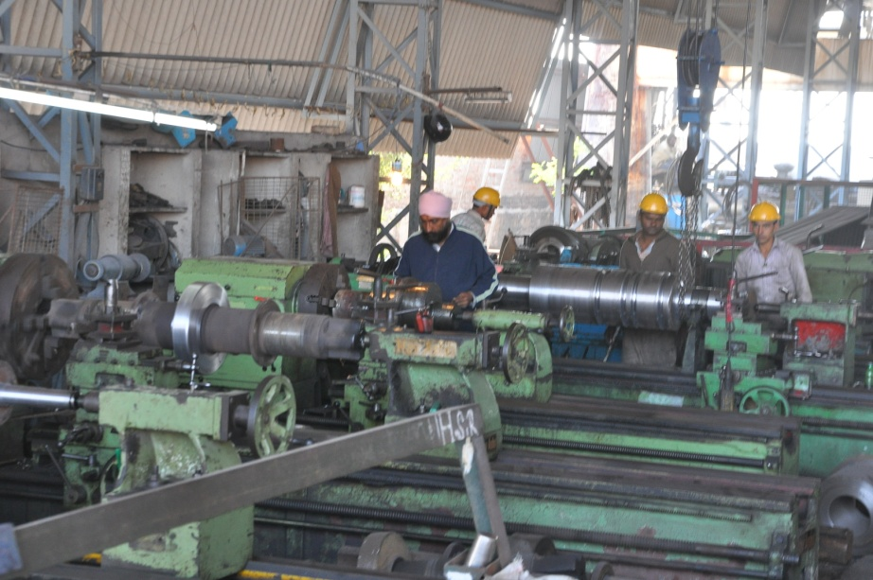
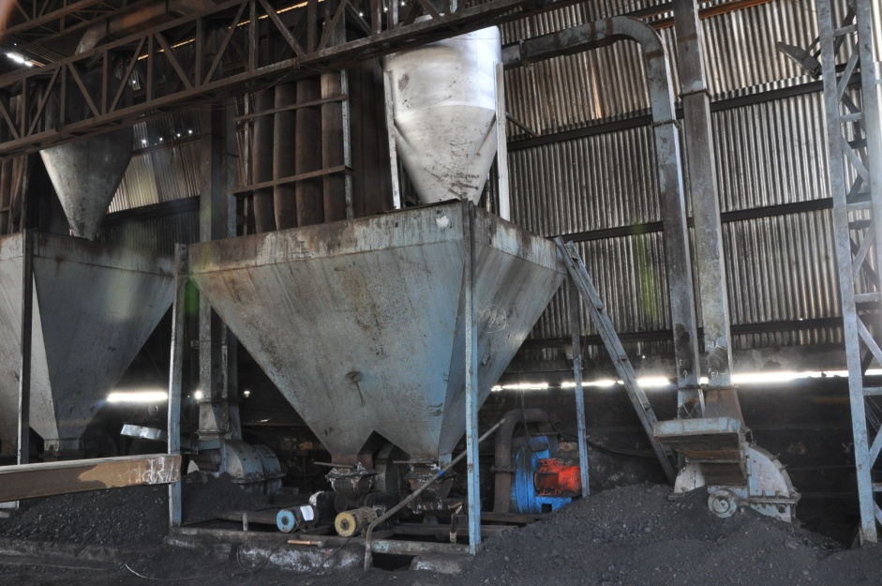
New Tech Machines

Slide 10
Thank You!

