Slide 1
CII – EXIM Conclave on India – Africa Project Partnership Creating Possibilities Delivering Value
18-20 March 2012 New Delhi India
Dr. Naresh Trehan
Chairman National Committee on Healthcare,
Chairman Medanta- The Medicity

Slide 2
CII – EXIM Conclave on India – Africa Project Partnership Creating Possibilities Delivering Value
18-20 March 2012 New Delhi India
Dr. Naresh Trehan
Chairman National Committee on Healthcare,
Chairman Medanta- The Medicity

Slide 3
CII – EXIM Conclave on India – Africa Project Partnership Creating Possibilities Delivering Value
18-20 March 2012 New Delhi India
Dr. Naresh Trehan
Chairman National Committee on Healthcare,
Chairman Medanta- The Medicity

Slide 4
Africa is Where India was 20 Years Ago...
Low life expectancy
Higher infant mortality
India 20 Years Ago...
Africa Today..
Dominated by the Public/ Charitable sector
India 20 years Back
Poor Accessibility
Low Insurance coverage
Poor Tertiary care facilities

Slide 5
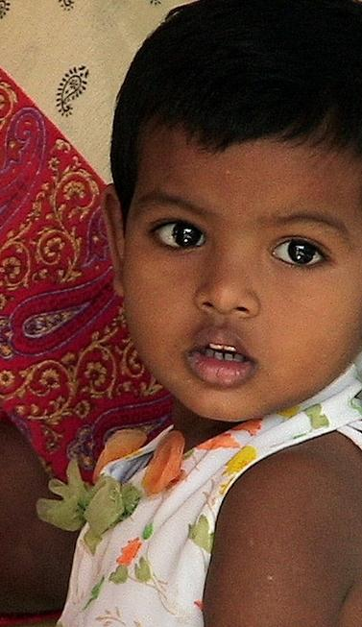
Healthcare Indicators | Africa Region | India
Life Expectancy at Birth | 54 | 65
Under 5 Mortality per 1000 Population | 127 | 66
Maternal Mortality Rate (per 10,000 live births) | 62 | 23
Healthcare Infrastructure | Africa Region | India
Physician (per 10,000 population) | 2.3 | 6
Nurses (Per 10,000 Population) | 10.9 | 13
Hospital Beds (Per 10,000 Population) | 0.1 | 9

Slide 6
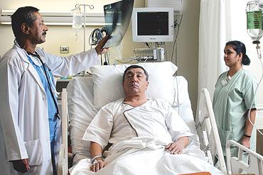
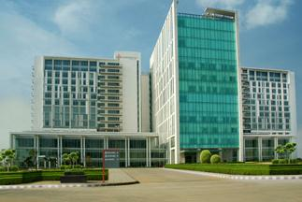
Indian Healthcare Today
High Quality low cost healthcare
World class doctors and other medical professionals
Increased accessibility of healthcare
Geographical Accessibility: has increased as many private hospital chains are opening in tier II and III towns
Financial Accessibility: New Social Schemes like RSBY, Private insurance increasing (Covers ~3% population)
Technological Accessibility: Telemedicine and m-Health

Slide 7
India: The world’s destination for Medical Care
Over 80,000 cardiac surgeries done per year with out comes at par with international standards
Multi organ transplants like Renal, Liver, Heart, Bone Marrow Transplants, are successfully performed at one tenth the cost
Last year over half a million foreign nationals visited India for medical treatments
Patients from over 55 countries treated at Indian Hospitals

Slide 8
Indian Healthcare : The Changing Scenario
Quality & Cost Advantage
PROCEDURE
COST (US$)
US
US
THAILAND
INDIA
UK
Heart Surgery
Bone Marrow Transplant
Liver Transplant
Knee Replacement
Cosmetic Surgery
40,000
2,50,000
3,00,000
20,000
20,000
7,500
-------
-------
8,000
3,500
6,000
26,000
69,000
6,000
2,000
23,000
1,50,000
2,00,000
12,000
10,000
Other Advanced surgeries in India:
Multi-organ transplants
Cardiac and Neuro Pediatric surgeries
Robotic Surgery

Slide 9
Corporate Hospitals Lead the Way
India has more than 1,000 corporate hospitals
Centers of Excellence spread all across India accredited by Joint Commission International; NABH etc
Today ~80% of healthcare delivery takes place in Private Hospitals
Corporate hospitals offer high quality low cost care
This model has been replicated globally

Slide 10
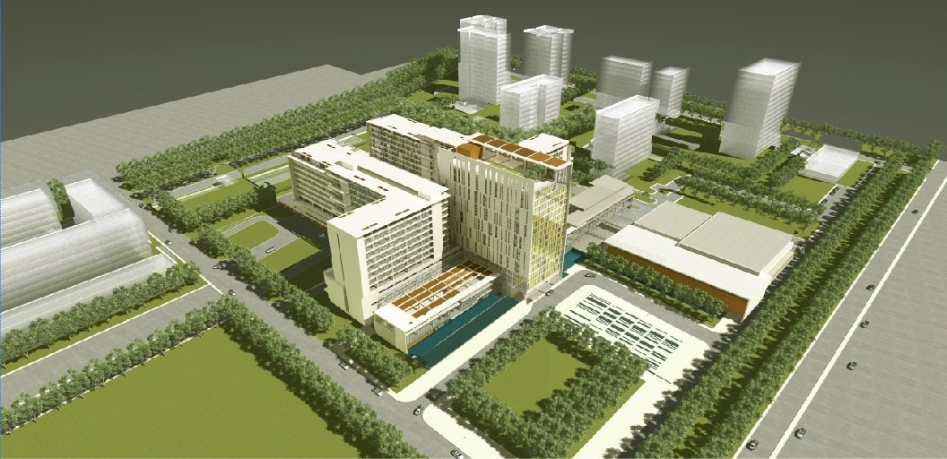
Medanta - The MediCity

Slide 11
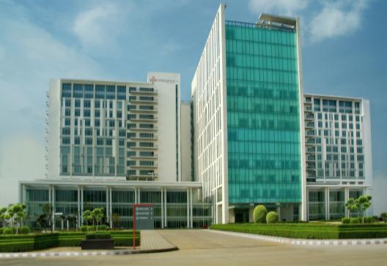
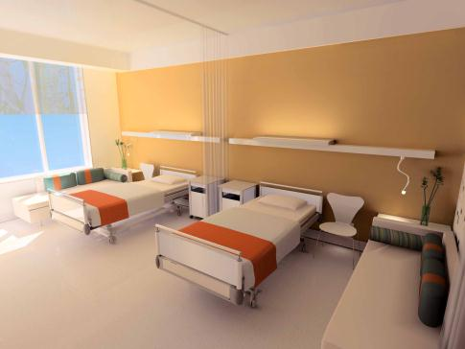
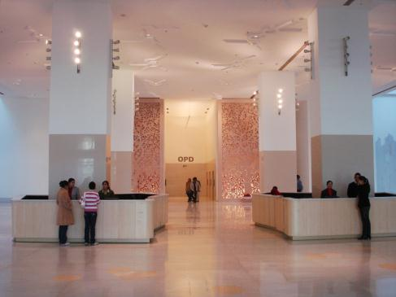
MEDANTA….OFFERINGS
Spread across 43 Acres has 45 Operating Theatres, 1250 beds & over 350 Critical Care Beds
Cutting Edge Technology
Multi-Super Specialty Institute catering to over 30 Specialties
World Class Research & Education facilities
Subsidized & Free Services for BPL Patients
Service CGHS, ECHS, ESI beneficiaries

Slide 12
List of Specialities:
Cardiology and Cardiovascular surgery
Oncology (including medical, radiation and surgical oncology services)
Neurosciences (neurology and neurosurgery)
Musculo-skeletal (advances orthopedics, joint replacements, rheumatology and physical medicine)
Transplant services
Minimal access surgery including robotic surgery
Nephrology
Advanced pediatrics, neonatology, gynecology and obstetrics
Ophthalmology
Internal medicine and respiratory medicine
Plastic and reconstructive surgery
Gastroenterology and Hepatology
Dermatology
Dental and oral health (including oral and maxillofacial surgery)
Endocrinology
ENT
Geriatrics

Slide 13
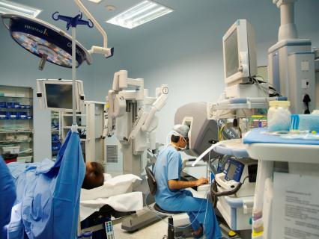
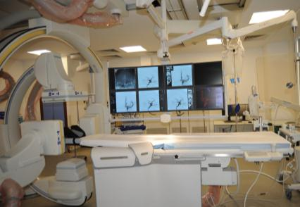
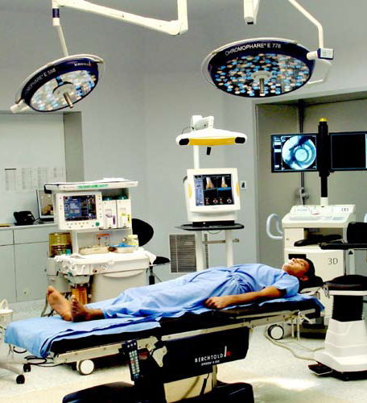
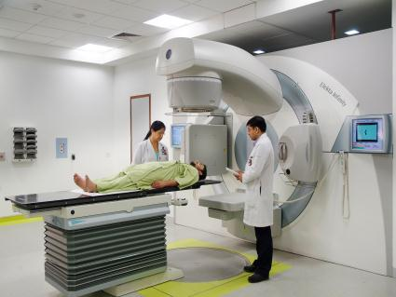
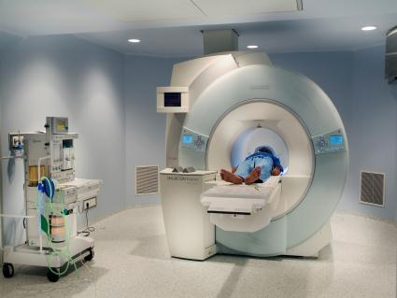
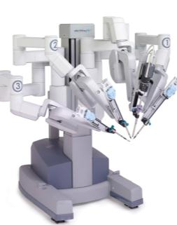
Our Technology
256 Slice CT
Brain Suite, Intra-Operative Imaging Operating Theater
Da Vinci Robot for Minimal Invasive Surgery
Artis- Zeego Endovascular Surgical Cath Lab
4 Linear Accelerators (provision for IGRT/ IMRT)
Tomotherapy
Integrated Brachytherapy Unit with remote controlled HDR
3.0 Tesla MRI
PET CT
Gamma Camera
16 Slice CT
Digital X-Ray, Fluoroscopy, Bone Densitometry
3D and 4D Ultra Sound
Mammography

Slide 14
Sharing India’s Healthcare Expertise
India’s healthcare growth story has provided us with a repository of knowledge and expertise
This can help Africa leapfrog to the next generation of healthcare

Slide 15
Efficient, Effective and Affordable System of Delivery
Three tier government delivery system
Primary: Primary Healthcare Centres
Secondary Care: District Hospitals
Tertiary Care: Teaching Institutions (AIIMS, PGI etc)
Government sponsored social health schemes
RSBY, Arogyashree
Private hospitals in India have developed some of the most cost effective healthcare delivery systems
Use of technology to increase accessibility
Large population in most remote areas of the county have now been connected through telemedicine.

Slide 16
Developing Human Resources
Medical Training Institution in India | Number of Institutes
Medical Colleges | 335
Nursing Colleges | 1500
Nursing Schools | 2500
An excellent ecosystem for training of
Doctors
Nurses,
Paramedical
Administrators
Public health specialists

Slide 17
India and Africa today have over 30% of the Worlds Population
Population Projection
India
Millions
Africa Region
Requirement of Physicians
Requirement of Nurses
Africa Region
Africa Region
India
India

Slide 18
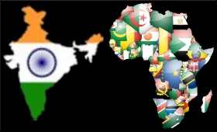
A partnership for Universal healthcare

Slide 19
Health Expenditure
Public Expenditure
Private Expenditure

