Slide 1
Biomass Power in India – An Overview by
VK JAIN
Director & NPC
Ministry of New & Renewable Energy
B- 14, CGO Complex, Lodhi Road
New Delhi -110003

Slide 2
Deployment of Renewable Power in the India
  MNRE – the Nodal Ministry of Govt. of India responsible for Development, Deployment and Promotion of Renewable Energy in the country.
  Total Installed Capacity of Power Generation - 1,86,654 MW
  RE based Power as on 31st Jan 2012 - 23,130 MW
  Contribution of RE Power - over 12%

Slide 3
Potential of Biomass Power in India
  Biomass – Renewable in Nature, Carbon Neutral and has the Potential to provide Large Productive Employment in Rural Areas.
  Potential
  Estimated Production of Crop - 540 MT / yr
  Agro industrial & Forest Residues
  Estimated Surplus Availability - 120-150 MT / yr
  Power Generation Potential - 16000 MW
  Cogeneration in Sugar Mills - 5000 MW
  Developed Biomass Resource Atlas based on Field Survey and Remote Sensing Data and is available on http://lab.cgpl.iisc.ernet.in/Atlas

Slide 4
Programmes for Promotion of Biomass Power
  National Programme on Grid Interactive Biomass Power and Bagasse Cogeneration
  Promote setting up of Biomass Power / Bagasse Cogeneration Projects by IIPs, Private / Cooperative / Public Sector Companies.
  National Programme based on Biomass Gasifier
  Gasifier based programme for off-grid / distributed power for Rural Areas
    Biomass gasifier based captive power generation in Rice Mills
    Biomass Gasifier based Grid Connected Power Programme
  National Programme on Biomass Energy and Cogeneration (Non Bagasse) in Industry

Slide 5
Financial and Fiscal Incentives
Central Financial Assistance
Capital Subsidy for setting up projects based on Biomass for generation of Power / Energy which generally varies from 5 -25 % of the project cost
Awareness Creation, Capacity Building, Publication of Newsletters, Resource Assessment, Technology Validation and Performance Monitoring and Evaluation.
Fiscal Incentives
Preferential Tariff announced by the state SERC’s.
Accelerated depreciation, concessional custom duty, excise duty exemption, tax exemption, income tax exemption on projects for power generation for 10 years and electricity duty exemption.

Slide 6
Status of Biomass Power in India
  Achievements as on 31st January 2012
  Biomass Power - 1142 MW
  Bagasse Cogeneration - 1952 MW
  Non-Bagasse Cogeneration - 347 MW
  Biomass Gasifier - 152 MW
  Total 3593 MW
  Major Barriers Impending Accelerated Deployment
  Inadequate Site Specific Information on Biomass Availability.
  Existence of Non-Formal Biomass Market and Trading.
  Problems associated with Management of Collection, Transportation, Processing and Storage of Biomass.
  Non - Versatility of Boilers to simultaneously take a variety of Biomass and cost effective sub MW systems.
  Availability of Finances.
  Existence of Conducive Policy and Regulatory Framework

Slide 7
UNDP /GEF Project on
“Removal of Barriers to Biomass Power Generation in India”
Project Components
  Identification of Barriers for Large Scale Deployment of Biomass Power through Technical Assistance.
  Setting up of MIPs to act as the Best Practices for faster Replication of Biomass Power in the Country.
Model Investment Projects (MIPs)
Supporting Implementation of different type of MIPs to address removal of barriers related to Technology, Sizing and Sustainability.

Slide 8
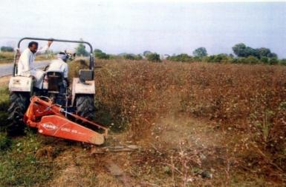
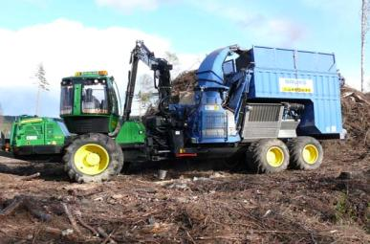
Infrastructure for Fuel Supply Linkages at M/s Malwa Power, Muktsar, Punjab

Slide 9
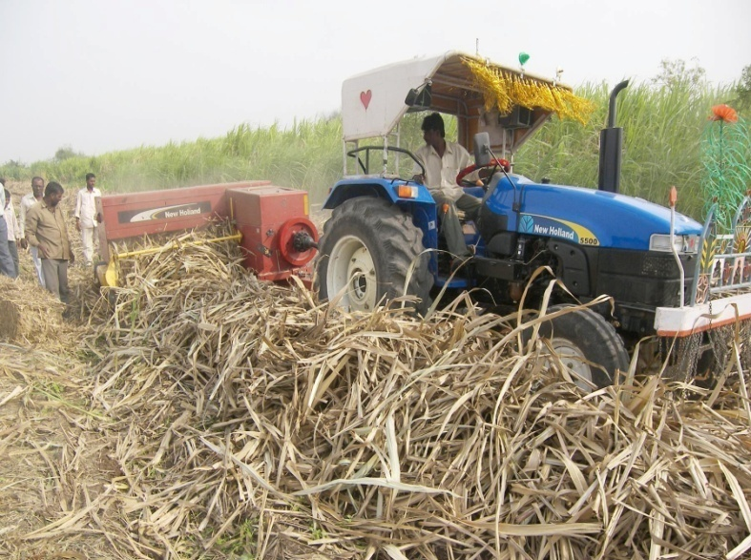
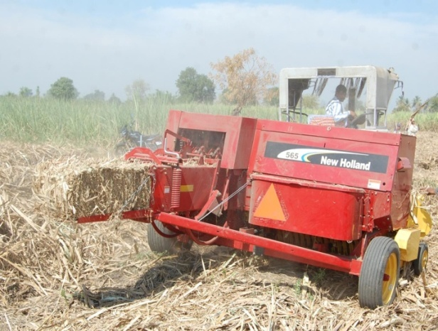
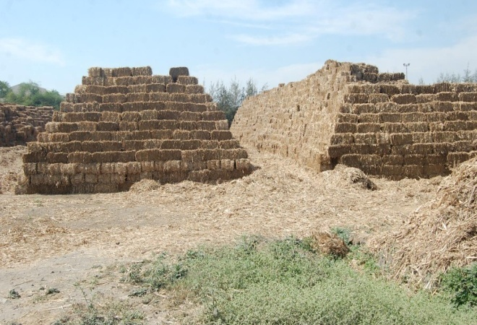
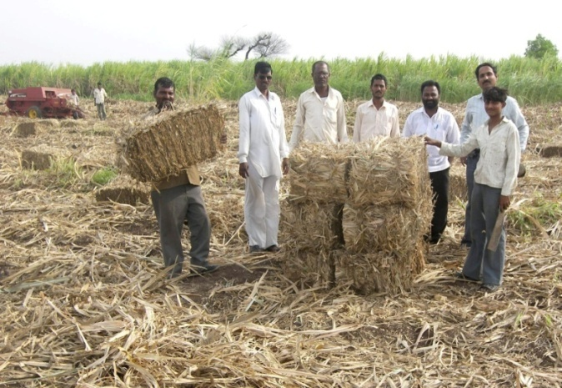
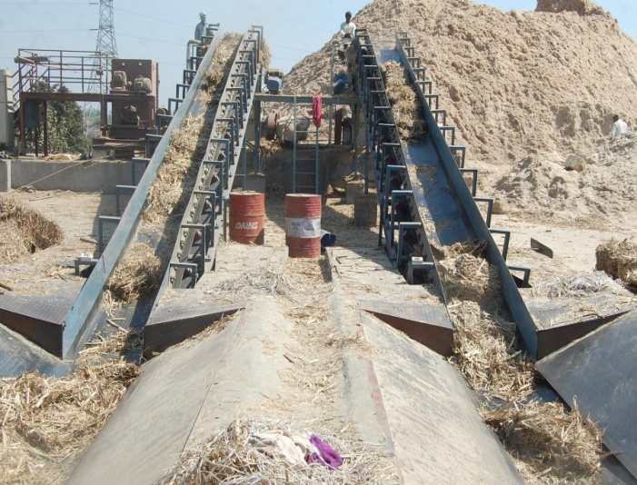
Fuel Supply Linkages at Cogeneration Plant at M/s SSK Pandurang, utilizing Sugar Cane Trash

Slide 10
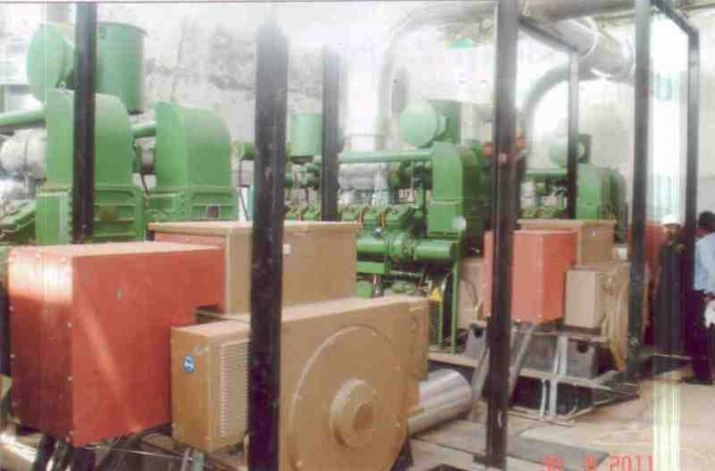
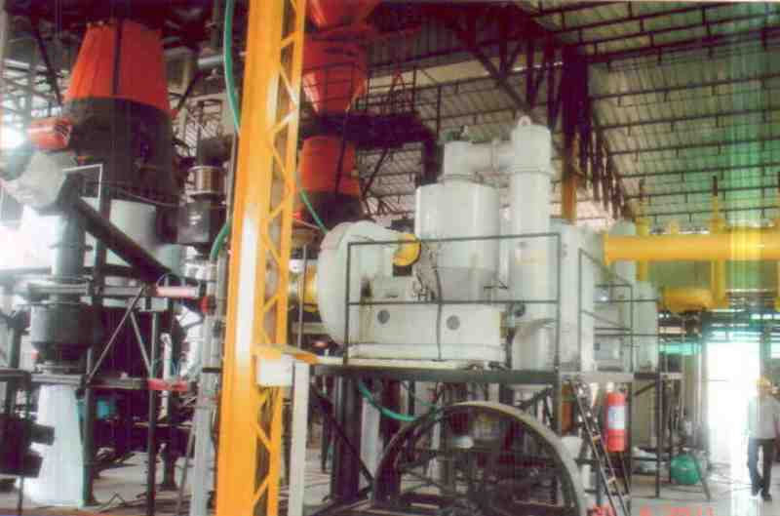
1.2 MW Grid Connected Biomass Power Project at M/s Ankur Scientific Energy Technologies, Sankheda, Vadodara, Gujarat

Slide 11
Thank You

