Slide 1
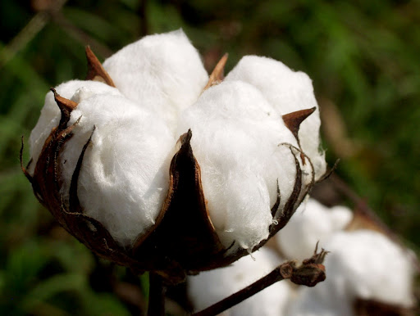
COTTON PRODUCTION STRATEGIES FOR AFRICAN COUNTRIES
PRESENTED BY:
EMAIL: info@luckyexpindia.com
WEBSITE: www.luckygroupcompanies.net

Slide 2
INTRODUCTION
Cotton, the white gold is one of the most important fiber crops. It plays an important role in the economy. In spite of severe competition from synthetic fiber, cotton continues to enjoy a place of prime importance in the textile and other related industries. The cotton products are being preferred to synthetic one due to increasing health consciousnesses of the people.

Slide 3
IMPORTANCE OF COTTON
The Cotton is grown in more than 80 countries of the world.
These countries produce 86% of the total world production and accounts for 82% of the acreage.
Beside fiber, cotton is also valued for its oil and cotton seed cake.
Following table will give top ten cotton producing countries of the world:

Slide 4
WORLD COTTON PRODUCTION
Name of the country | Area in Million Ha. | Yield kg/Ha. | Production Million Bales
China | 5.50 | 1326 | 33.50
India | 12.20 | 591 | 27.50
USA | 3.99 | 890 | 16.30
Pakistan | 3.20 | 680 | 10.00
Brazil | 1.40 | 1400 | 9.00
Uzbekistan | 1.34 | 530 | 4.20
Australia | 0.60 | 1814 | 5.00
Turkey | 0.48 | 1406 | 3.10
Turkmenistan | 0.58 | 530 | 1.40
Greece | 0.30 | 980 | 1.35
USDA ANNUAL REPORT-2011

Slide 5
COTTON IN AFRICA AREA, YIELD & PRODUCTION
Name of the country | Area in Million Ha. | Yield K.G. Ha. | Production in Million Bales
Mali | 0.48 | 630 | 0.80
Egypt | 0.22 | 800 | 0.78
Burkina | 0.40 | 380 | 0.70
Zimbabwe | 0.43 | 290 | 0.58
Nigeria | 0.36 | 420 | 0.40
Côte d'Ivoire | 0.22 | 380 | 0.39
Benin | 0.17 | 410 | 0.33
Cameroon | 0.18 | 400 | 0.33
Chad | 0.12 | 210 | 0.12
Togo | 0.08 | 310 | 0.10
Senegal | 0.04 | 410 | 0.08

Slide 6
COTTON SECTOR IN AFRICA
Africa accounts for 10 to 15% of the world cotton export.
Cotton is of significant importance to many African Countries, as it is one of the important foreign exchange earners.
Cotton related activities, account for a large share of rural employment & key factors for poverty reduction.
About six million people are involved in the cotton industry in West and Central Africa.
Although each country is having its own policy. It is possible to give a brief review of some of the common features of recent development.

Slide 7
BRIEF REVIEW OF SOME OF THE COMMON FEATURES
Govt. agencies supply most of the inputs used in cotton production.
Productivity continues to be hampered by the outdated techniques and equipment.
Problems related to storage and infrastructure, make transactions more expensive.
Ginning facilities are out dated resulting in poor recovery & damage of fiber.
Only 6% of the cotton is locally made into product rest, is exported in farm of raw cotton.
Very little efforts have been made for improvement of the cotton varieties and use of hybrid techniques.

Slide 8
REASONS FOR LOW YIELD OF COTTON IN AFRICA
Cotton is grown by small & marginal farmers having about 10 to 15 percent area under irrigation.
Low yielding cotton varieties, non availability of hybrid cotton and restriction on use of Bt Cotton.
Insufficient use of organic and inorganic fertilizers.
Little efforts to generate awareness for Harvesting of rain water and its utilization.
Unplanned use of agricultural chemicals resulting in, increase in the cost of cultivation.
Non availability of market information and price support policy.

Slide 9
HIGH INPUT HIGH OUTPUT POLICY FOLLOWED BY DEVELOPED COUNTRIES
 | USA | CHINA | AUSTRALIA | EGYPT | INDIA (50% Rainfed)
CULTIVAR | 100% area Bt. Cotton | 100% area Bt. Cotton | 100% area Bt. Cotton | 100% area Bt. Cotton | 85% area Bt. / Hybrid cotton
FERTILIZER | 150-100-150 of NPK | 300 – 150 – 400 of NPK | 250-250-150 of NPK | 300-250-250 of NPK | 50-25-25 of NPK
PESTICIDE | 5-8 Spray | 5 – 6 Spray | 5 – 6 Spray | 5 – 6 Spray | 2 – 3 Spray
CROP DURATION | 8 Month | 6 Month | 8 Month | 8 Month | 5 Month

Slide 10
BIO FERTILIZERS IN COTTON AND THEIR FUNCTIONS
Name of Bio-fertilizers | Functions | Fertilizer equivalent/ input in terms of crop yield/ha
A. Nitrogen biofertilisers 1. Azotobacter (Non-symbiotic) | - Fixes 20-40 kg N/ha - 10-15% increase in yield - Maintains soil fertility - Biological control of plant pathogens. | 20 Kg N
2. Azospirillum | - Fixes 20-40 kg N/ha - Maintain growth promoting bacteria - Increased mineral and water uptake, - 10-15% increase in yield | 20 Kg N
B) Phosphorus Solubilising microorganisms (PSM)- | - Solubilises insoluble phosphate, Increases P-uptake capacity Improves soil fertility and helps in development of root and moisture stress | 30-50 Kg P2O5

Slide 11
NUTRIENT MANAGEMENT
Sulphur coated urea and neem cake coated urea improved the efficiency of applied nitrogen.
Urea + Farm Yard Manure and neem cake treated urea as a top dressig were found to be efficient.
Supplementing half of the recommended dose of fertilizer with bio-fertilizer, significantly increased cotton yield.
Sulphur application @ 10 kg/ha significantly increased the yield.
Under rainfed conditions phosphate application at 40 kg/ha placed at 7.5 cm, was superior to other treatments.
Foliar application of 2% urea or DAP at 60 and 80 days improved the yield by 15%.
Alternate sprays of potassium @ 1% and DAP @ 2% was beneficial for high yield.
In the studies on long term effect of nutrient management, cotton- sorghum rotation out yielded cotton mono crop by 38%.
Seed treatment with bio-fertilizers with half the recommended doses of fertilizer gave better yield.

Slide 12
REFORM IN COTTON PRODUCTION IN INDIA
The agriculture situation in India was similar to Africa. Introduction of Reforms has made the difference.
Prompt availability of loan through commercial or cooperative bank on the basis or area under cultivation.
Freely available & market oriented supply of organic, inorganic fertilizer and plant protection chemicals.
No restriction on the use of varities, farmer can use open pollinated, hybrid or Bt. Cotton as per their convenience .
Introduction of crop insurance on cotton.
Modernization of ginning and pressing plants at production centers.
Free market for the sale of the product, without any restriction or embargo from the Government.
Price support system to give reasonable return to the farmers.

Slide 13
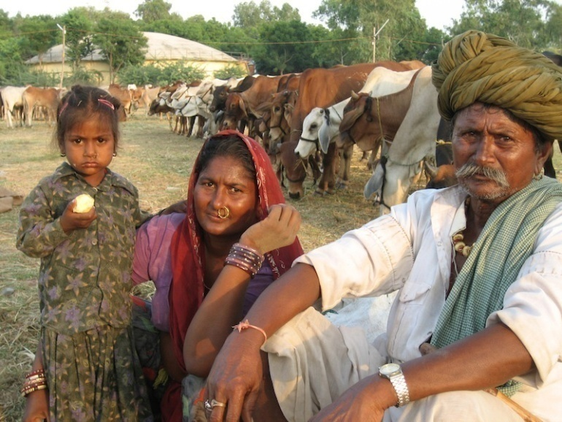
EFFECT OF THE ABOVE REFORMS ON ECONOMY
Farmers income increased by 45-50%.
They started building RCC houses for themselves.
Purchase of tractor, car and motorbike.
Sending their children to public school.
Providing better health and living conditions to their family members.

Slide 14
JOB UNDERTAKEN BY
THE LUCKY GROUP OF COMPANIES IN SUDAN
Lucky Group of companies in collaboration with Agricultural Research Corporation (ARC) of Sudan Govt. has under taken projects for improvement of cotton in that country.
Six hybrid varieties were introduced from India and were tried at randomized block design trials, at two locations.
Bt cotton was also introduced under controlled conditions and trials were conducted in the Poly House for back crossing of Indian Bt. Cotton with Sudanese varieties for three generation to get F3, using Indian varieties as a male partner.
At the third generation (F3 progeny) will have 50% genes of Bt. Cotton and 50% genes of Sudan origin.

Slide 15
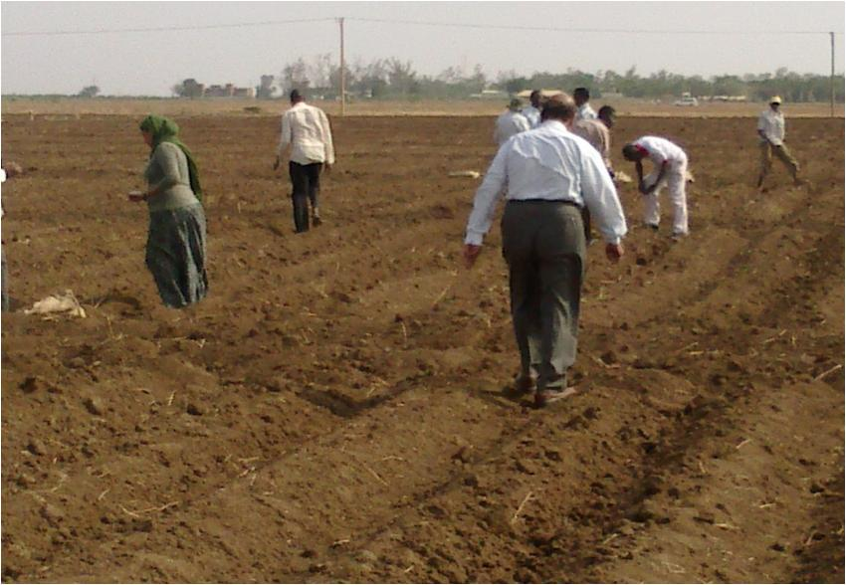
LAYOUT OF THE TRIAL AT SUDAN

Slide 16
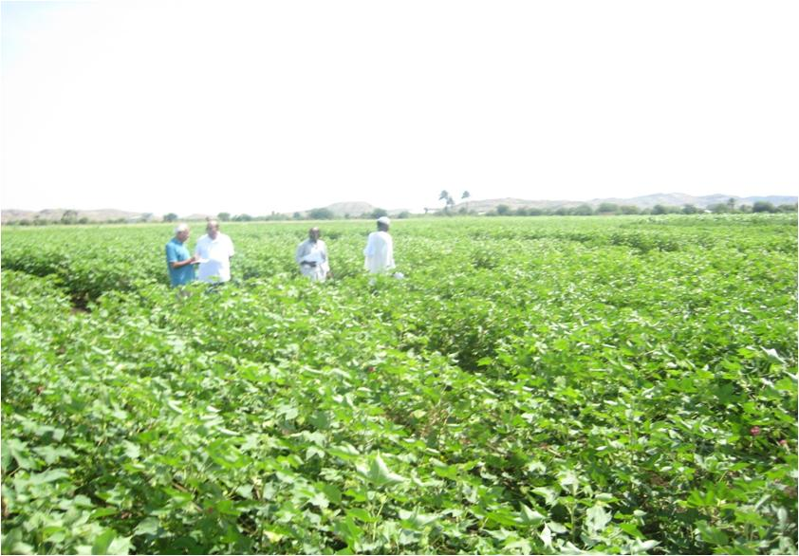
VIEW OF THE SUDAN TRIAL

Slide 17
HYBRID COTTON TRIAL - AT RAHAD RESEARCH STATION (SUDAN)
Varities | Replication 1 (yield kg /ha) | Replication2 (yield kg /ha) | Replication3 (yield kg /ha) | Replication4 (yield kg /ha) | Average (yield kg /ha)
HYBRID 1 | 3334.2 | 3168.7 | 3162.7 | 3343.3 | 3252.2
HYBRID 2 | 2501.0 | 2583.3 | 3003.0 | 2505.0 | 2648.1
HYBRID 3 | 2003.0 | 2083.3 | 2169.7 | 3250 | 2376.5
HYBRID 4 | 3083.3 | 2926.7 | 2916.7 | 3086.3 | 3003.3
HYBRID 5 | 2667.1 | 3002.0 | 3336.3 | 2418.7 | 2856.0
HYBRID 6 | 2503.4 | 3163.7 | 3166.7 | 2343.3 | 2794.3
Hamid (Sudan) | 2917.7 | 2750.0 | 2664.7 | 3353.3 | 2921.4
Abdin (Sudan) | 2334.3 | 2504.0 | 3339.3 | 2436.7 | 2653.6
Performance of two Indian Hybrid No. 1 & No. 4 where superior to other Indian & Sudanese varities under Sudan condition & taken for further trials.

Slide 18
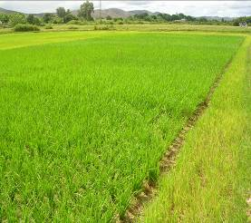
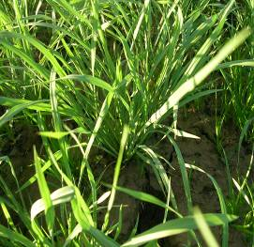
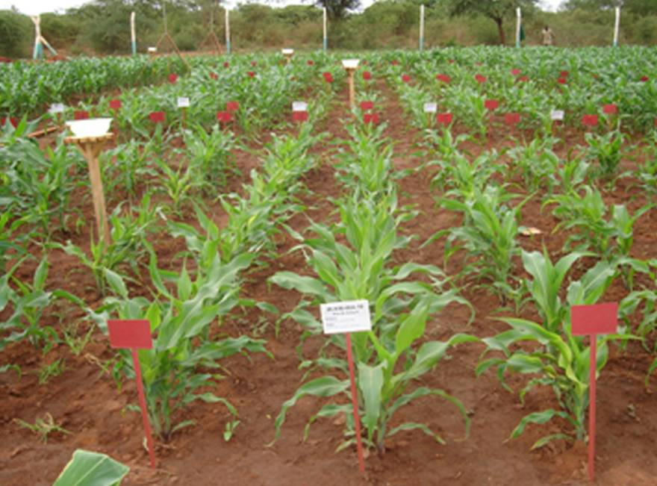
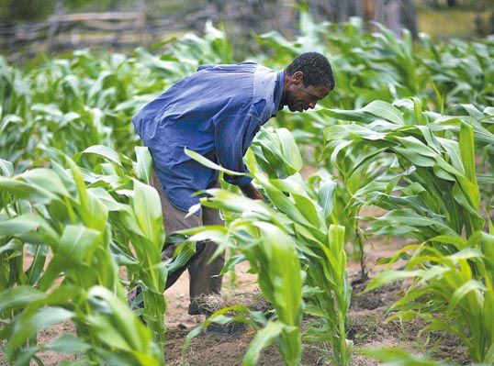
Beside Cotton development program in Sudan Lucky group has also under taken projects in the following countries .
Enhancement of Rice yield in the MADAGASCAR.
Maize development program in SUDAN.

Slide 19
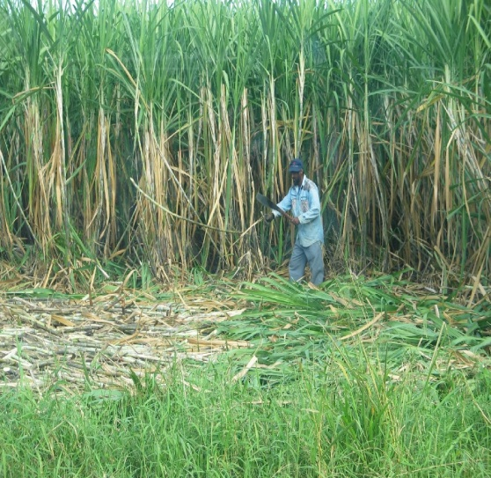
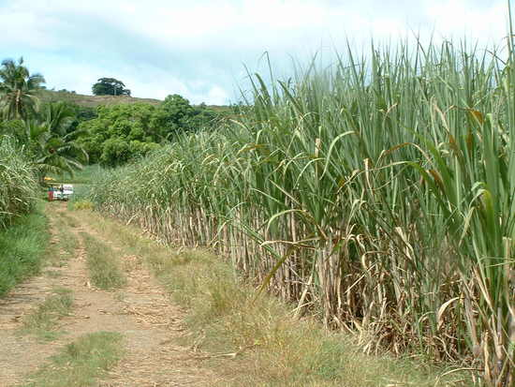
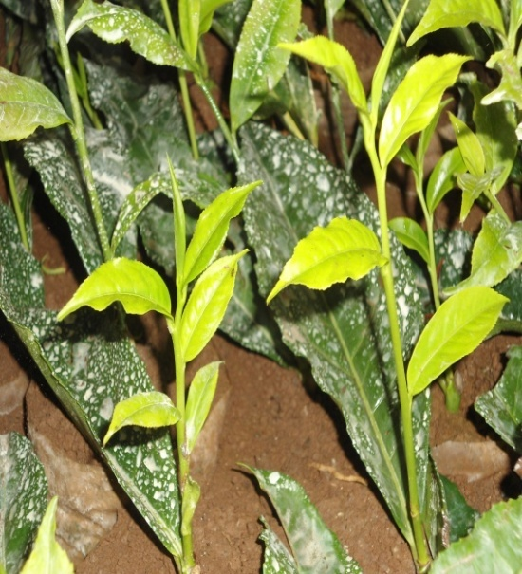
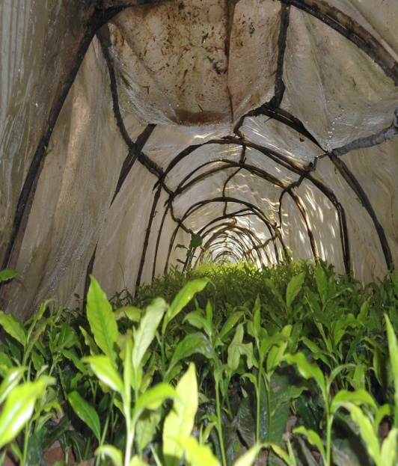
Sugarcane development in ERITREA.
Tea development program in ETHIOPIA.

Slide 20
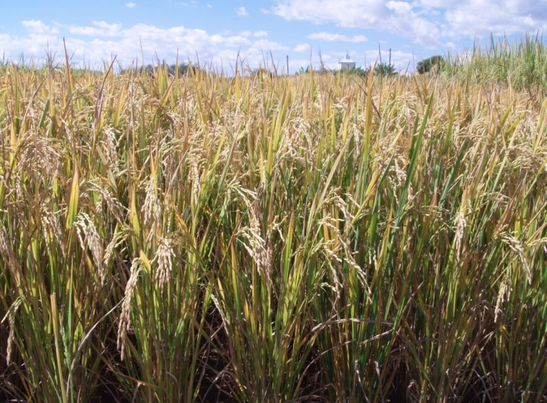
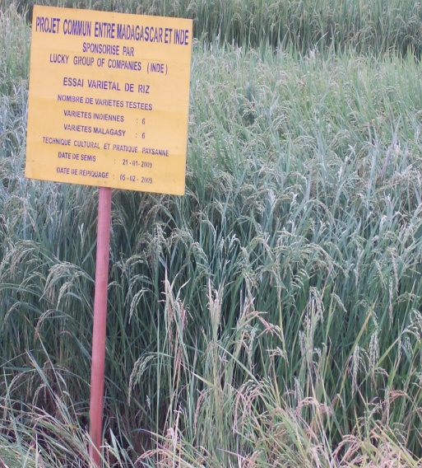
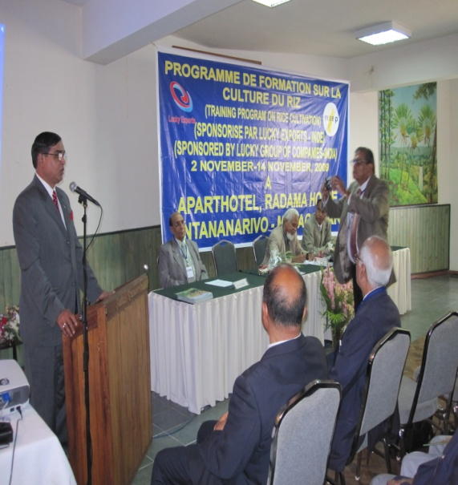
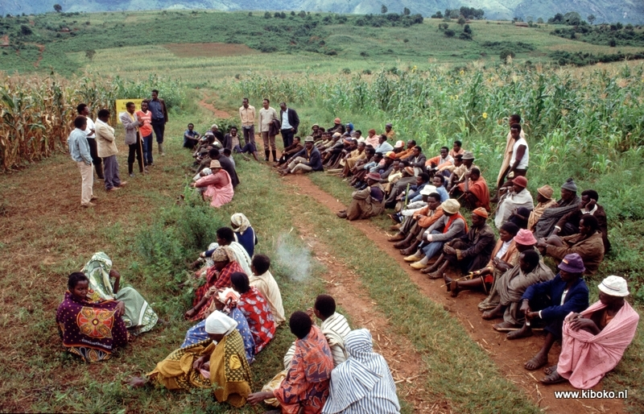
Rice production in Ivory Cost.
Demonstration & Training Program in MADAGASCAR

Slide 21
SERVICES OFFERED BY LUCKY GROUP
Complete Solution for Rice, wheat, maize, cotton & Sugarcane with assured increase in yield
Supply of Bio-Fertilizers & installation of Bio-Fertilizer plant
Erection & Commissioning of NPK Granulation Plant & Single Super Phosphate plant
Supply of Organic and synthetic pesticide for control of pest and diseases
Supply of hybrid cotton & maize seeds and high yielding varieties of wheat & rice
To set-up Soil-testing Lab and provide soil testing services
Supply of tractor, tractor-drawn implements and irrigation pumps of different capacity including solar pumps
Demonstration on crops in rural areas along with training to extension workers and farmers

Slide 22
Thank
You

